Slide 1

Cochise Linux User Group

Slide 2
How To Update Your Computer

Slide 3
How To Update Your Computer
Software Updater
Terminal Emulator
Synaptic Package Manager

Slide 4
1 Software Updater
Most Linux OS’s have a Software Updater. They are called by different names.
Search for your distro’s updater and launch it.
It will check if there any updates available for your system.
If there are updates available, it will give you the option to install the updates.

Slide 5
2 Terminal Emulator
Depending upon your distro the commands to update your system will vary.

Slide 6
Debian/Ubuntu
In Debian/Ubuntu or distros based on them you will use:
sudo apt update
This command updates the local database of available packages. If you don’t run this command, the local database won’t be updated and your system will not know if there are any new versions of packages available.
It tells you how many packages can be upgraded. You can see these packages by running the following command:
apt list --upgradable

Slide 7
Debian/Ubuntu
The second command is:
sudo apt upgrade
This command matches the versions of installed packages with the local database. It collects all of them, and then it will list those packages that have a newer version available. At this point, it will ask if you want to upgrade the installed packages to the newer version.
You will select y to install or n not to install. Or simply hit enter and they will be installed.

Slide 8
Debian/Ubuntu
Alternatively you can enter both commands simultaneously:
sudo apt update && sudo apt upgrade
And it will do both functions

Slide 9
RHEL & CENTOS
yum (yellowdog updater, modified) is used instead of apt
sudo yum check-update
sudo yum update

Slide 10
Arch Linux
The commands are:
sudo pacman -Syu
sudo pacman -Su

Slide 11
Arch Linux
You can also use the command:
sudo pacman -Syyu
The extra y forces the package manager to download package database regardless of whether there is any change in the versions or not.
This is helpful when you have a corrupted package database and you want to force a synchronization.
However, it will unnecessarily take a long time in synchronizing the database. It will also consume more network bandwidth.

Slide 12
SUSE
The commands are:
sudo zypper refresh (or sudo zypper ref)
sudo zypper list-patches (or sudo zypper lp)
sudo zypper list-updates (or sudo zypper lu)
sudo zypper update (or sudo zypper up)

Slide 13
Gentoo
The commands are:
su -
emerge --update @world
This command updates the Gentoo repository
emerge --update --ask @world
This command will tell Portage to display the list of packages it wants to upgrade and ask for confirmation.
Portage will then search for newer version of the applications that are installed. However, it will only verify the versions for the applications that are explicitly installed (the applications listed in /var/lib/portage/world) - it does not thoroughly check their dependencies.

Slide 14
Gentoo
emerge --update --deep @world
This command updates the dependencies of those packages as well.
emerge --update --deep --with-bdeps=y @world
This command includes some packages on the system are needed during the compile and build process of packages, but once that package is installed, these dependencies are no longer required.
emerge --update --deep --with-bdeps=y --newuse @world
This command is used if the USE settings have been changed. Portage will then verify if the change requires the installation of new packages or recompilation of existing ones

Slide 15
3 Synaptic Package Manager
Available only in Debian/Ubuntu based OS’s
If not installed use “sudo apt install synaptic” to install it

Slide 16
Synaptic Package Manager
Launch Synaptic from the main menu

Slide 17
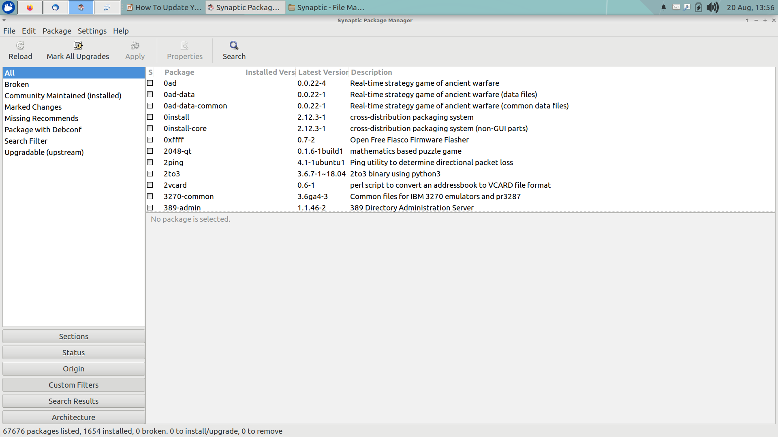
Synaptic Package Manager

Slide 18
Synaptic Package Manager
Select Custom Filters
And then Upgradable (Upstream)
Alternatively

Slide 19
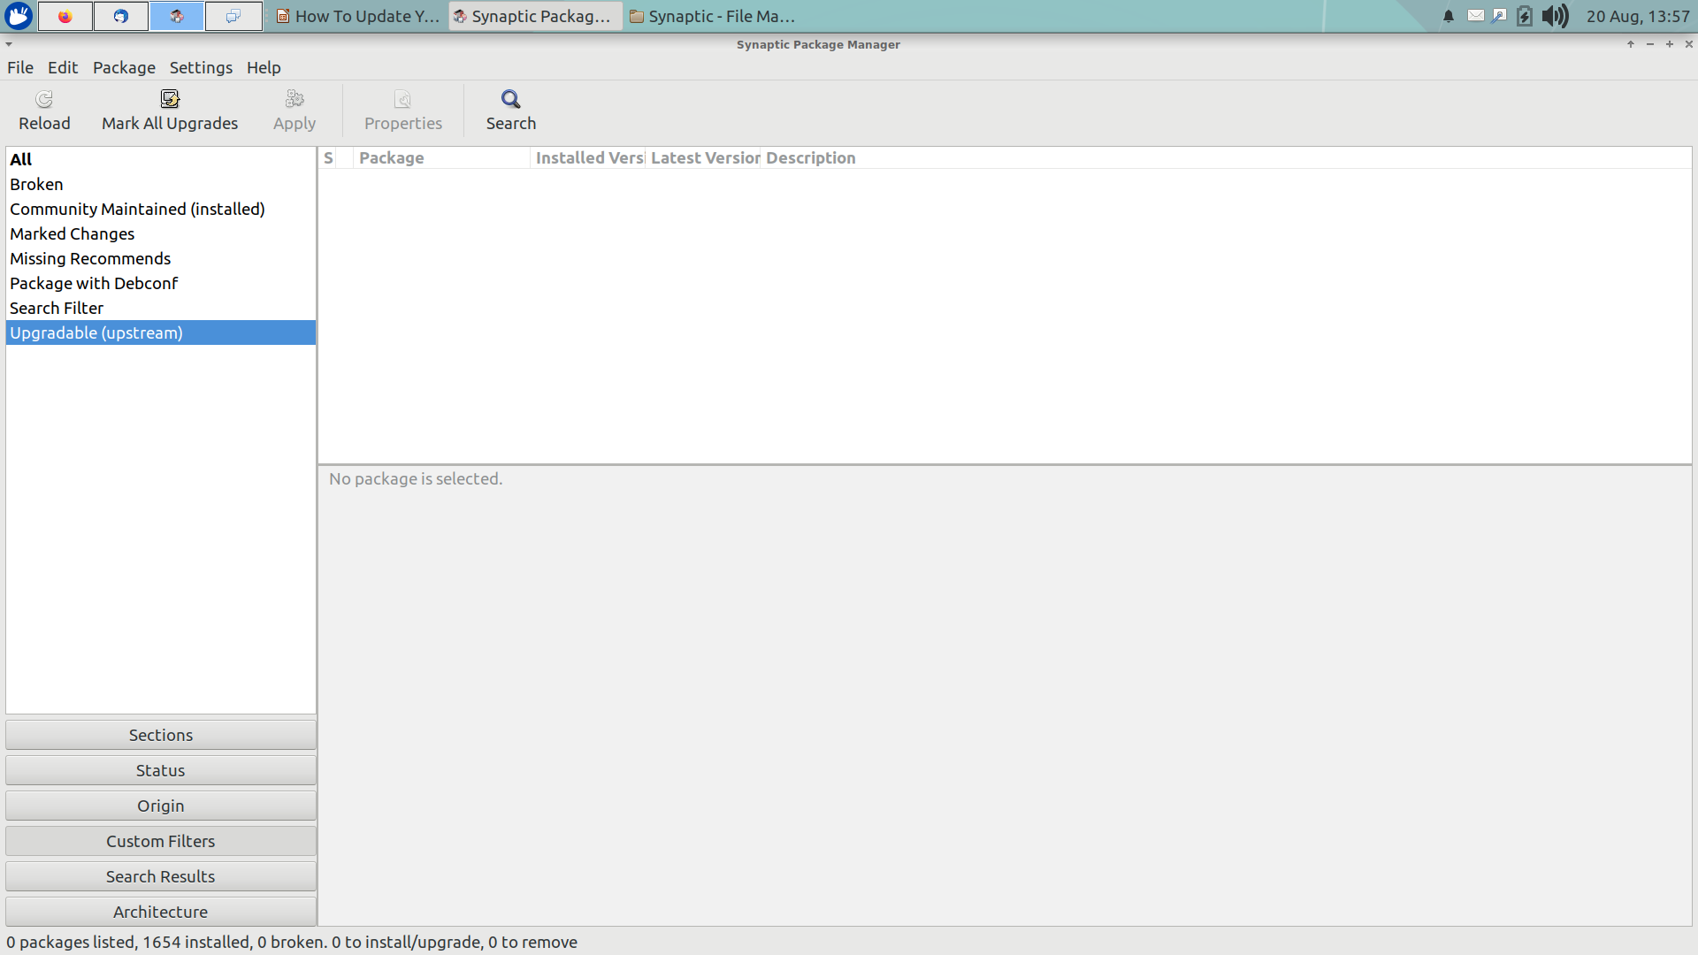
Synaptic Package Manager

Slide 20
Synaptic Package Manager
Check the desired upgrades
Select Apply

Slide 21
How To Update Your Computer
A copy of these slides can be downloaded from our website:
https://github.com/CochiseLinuxUsersGroup/Presentations

Slide 22
Cochise Linux User Group

